Slide 1
PARADISE LOST
BY JOHN MILTON

Slide 2
JOHN MILTON
John Milton (9 December 1608 – 8 November 1674) was an English poet and intellectual. He served as a civil servant for the Commonwealth of England under its Council of State.
Writing in English, Latin, and Italian, Milton achieved global fame and recognition during his lifetime
His celebrated Areopagitica (1644), written in condemnation of pre-publication censorship, is among history's most influential and impassioned defences of freedom of speech and freedom of the press.
He was the first modern writer to employ unrhymed verse outside of the theatre or translations.

Slide 3
PERSONAL LIFE
John Milton was born in Bread Street, London, on 9 December 1608, the son of composer John Milton and his wife Sarah Jeffrey.
The prosperity of Milton's father allowed him to obtain a private tutor, Thomas Young, a Scottish Presbyterian with a MA from the University of St. Andrews.
Young's influence also served as the poet's introduction to religious radicalism.
After Young's tutorship, Milton attended St Paul's School in London, where he began the study of Latin and Greek; the classical languages left an imprint on both his poetry and prose in English.

Slide 4
HIS POETRY
Milton's poetry was slow to see the light of day, at least under his name.
His first published poem was "On Shakespeare" (1630), anonymously included in the Second Folio edition of William Shakespeare's plays in 1632.
An annotated copy of the First Folio has been suggested to contain marginal notes by Milton.^{[54]}
Milton collected his work in 1645 Poems in the midst of the excitement attending the possibility of establishing a new English government.
The anonymous edition of Comus was published in 1637, and the publication of Lycidas in 1638 in Justa Edouardo King Naufrago was signed J. M. Otherwise.
The 1645 collection was the only poetry of his to see print until Paradise Lost appeared in 1667.

Slide 5
PARADISE LOST
Paradise Lost is an epic poem in blank verse by the 17th-century English poet John Milton.
The first version, published in 1667, consists of ten books with over ten thousand lines of verse. A second edition followed in 1674, arranged into twelve books with minor revisions throughout.
It is considered to be Milton's masterpiece, and it helped solidify his reputation as one of the greatest English poets of all time.^{[3]}
The poem concerns the biblical story of the Fall of Man: the temptation of Adam and Eve by the fallen angel Satan and their expulsion from the Garden of Eden.

Slide 6
Paradise Lost recreates the biblical story of the fall of man, starting with the first fall, that of a group of rebel angels in Heaven. Satan, one of God’s most cherished and powerful angels, grows angry when God creates the Son and proclaims that Son as leader. Satan asserts his own authority and power when he organizes a group of rebel angels against God, leading to the Angelic War, which ends in no deaths but much pain. The Son defeats the rebels, who are cast into Hell.
After this civil war, God creates the first man, Adam. Lonely, Adam requests a companion, and so God makes Eve from Adam’s flesh. Eve is beautiful, intelligent, and in love with Adam; she is also curious and hungry for knowledge. Adam and Eve begin in a close relationship with God. They live in Paradise, in the Garden of Eden. God gives them the power to rule over all creation with only one command: They cannot eat fruit from the Tree of Knowledge. God warns that if they eat from the tree, they will die.

Slide 7
Meanwhile, in Hell, Satan concocts a plan to destroy man in an act of revenge. He journeys to Earth, tricking the angel Uriel into showing him where man lives. After finding Adam and Eve in Paradise, he grows jealous of them, for they have God’s favor. He overhears Adam and Eve talking about the forbidden fruit. He disguises himself as a serpent, cunning and deceptive. He tricks Eve into eating the forbidden fruit.
Adam learns of Eve’s sin and knows that she must die. He chooses to eat the forbidden fruit, too, feeling bound to Eve because they are from the same flesh. Adam and Eve both know they have sinned. They fall asleep and have terrible nightmares. When they awake, they both feel guilt and shame for disobeying God. On bended knee, they beg God for forgiveness.

Slide 8
With mankind fallen, Satan returns to Hell to celebrate his triumph. As soon as he finishes his victory speech, he and all his followers turn into snakes without limbs or the ability to speak.
God sends the Archangel Michael to escort Adam and Eve from Paradise. Before expelling them, Michael shows Adam the future—the events resulting from the original sin. The vision shows everything that will happen to mankind, tracing events from Cain and Abel up to the redemption of sin through Jesus Christ. With a mixture of sadness and hope, Adam and Eve leave Paradise.

Slide 9
THEMES
Hierarchy and Order
In portraying the “Fall of Man” and the war in Heaven, Milton spends much of Paradise Lost describing the universal hierarchy and order that these events upset. In his viewS Heaven exists above, Earth below, and Hell and Chaos below that. Within this geographically ordered cosmos, the most important hierarchy of Heaven is that of God as supreme monarch, the creator and ruler of the universe.
Disobedience and Revolt
Paradise Lost is about the fall of humanity and the rebellion of Satan and his angels, so the plot and conflict almost entirely come from acts of revolt against the hierarchy of God’s universe. The “Fall” comes when Satan grows jealous of God honoring the Son so highly

Slide 10
Sin and Innocence
Paradise Lost is basically a dramatization of the “original sin,” the explanation of how evil entered a world that began as God’s perfect creation. For a Christian like Milton, sin is everything that breaks God’s laws, including acts that do harm to other humans and acts that upset the hierarchy of the universe.
Free Will and Predestination
In Paradise Lost Milton argues that though God foresaw the Fall of Man, he still didn’t influence Adam and Eve’s free will. God specifically says that he gives his creatures the option to serve or disobey, as he wants obedience that is freely given, not forced.
Love and Marriage
Love is one of the Christian God’s most important attributes, and Heavenly love also takes center stage early in the poem as the angels ceaselessly worship God and commune with each other in joy, and the Son offers himself as a sacrifice for humankind out of love for them. Then when Adam and Eve are created, the poem partly shifts its focus to mortal love and the idea of marriage.

Slide 11
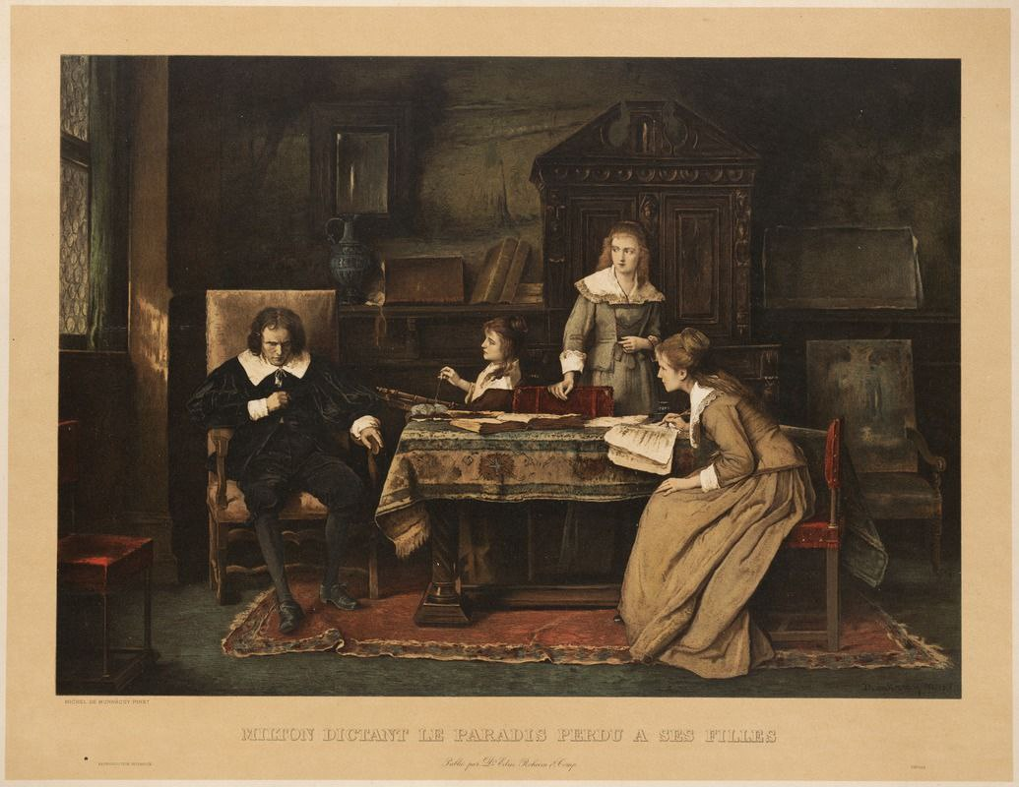
As a blind poet, Milton dictated his verse to a series of aides in his employ.
It has been argued that the poem reflects his personal despair at the failure of the Revolution yet affirms an ultimate optimism in human potential.
Some literary critics have argued that Milton encoded many references to his unyielding support for the "Good Old Cause".^{[55]}

Slide 12
THANKYOU

